Slide 1

SMART INDIA HACKATHON 2026
TITLE PAGE
Problem Statement ID – 26143
Problem Statement Title- Leveraging satellite imagery to detect oil spills at sea, correlated with AIS data to identify responsible vessels
Theme- Disaster Management
PS Category- Software
Team ID-
Team Name (Registered on portal)- SINGULARITY

Slide 2
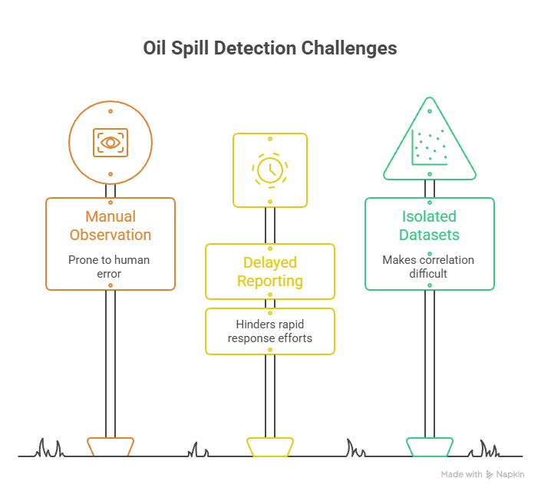
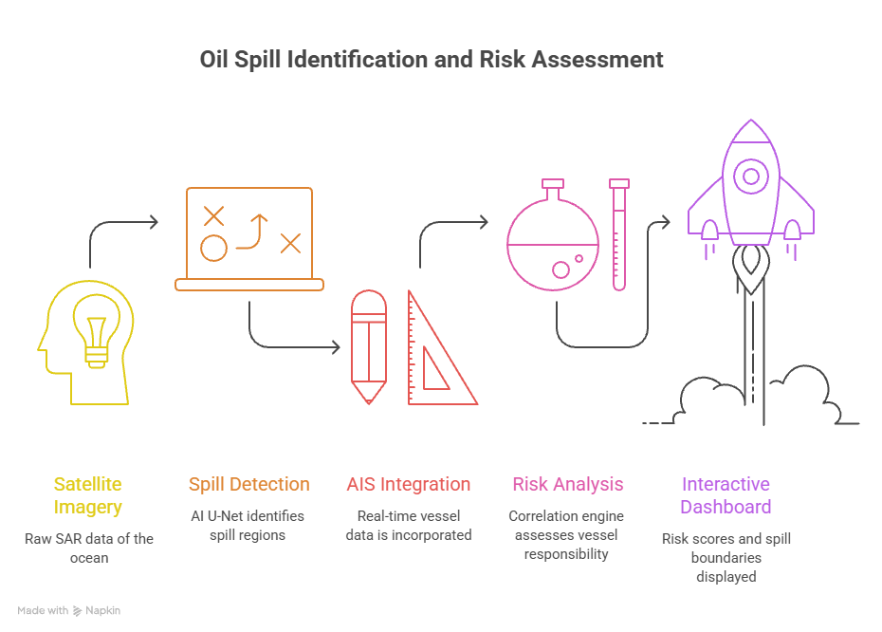
IDEA TITLE
SINGULARITY

Slide 3
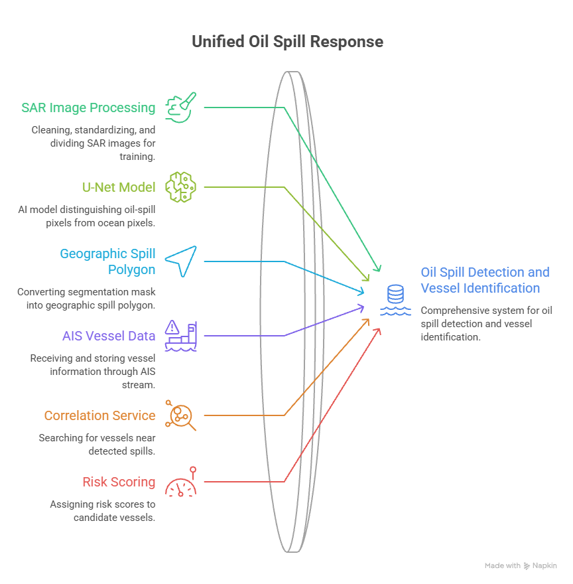
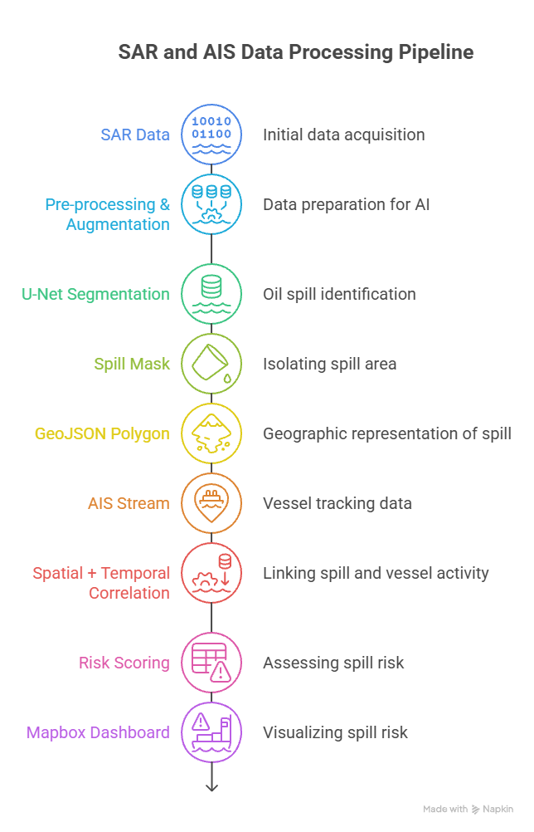
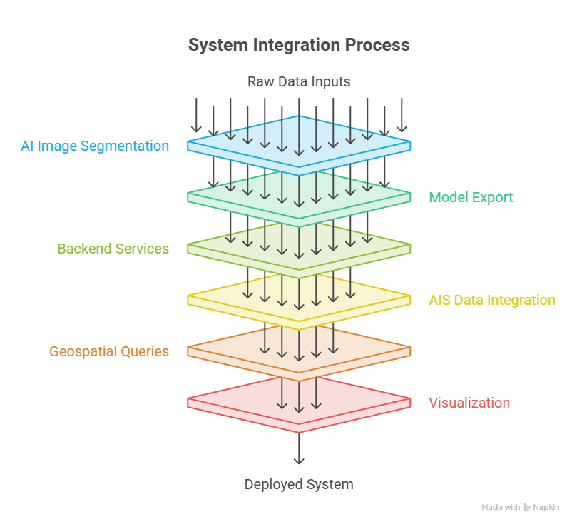
TECHNICAL APPROACH
SINGULARITY

Slide 4
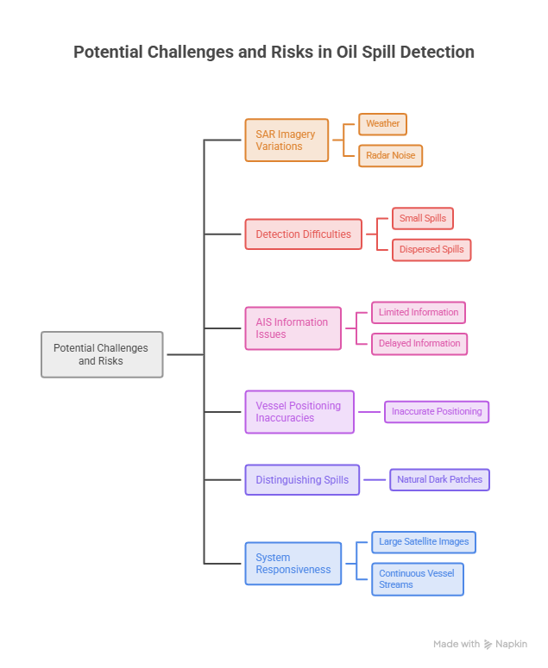
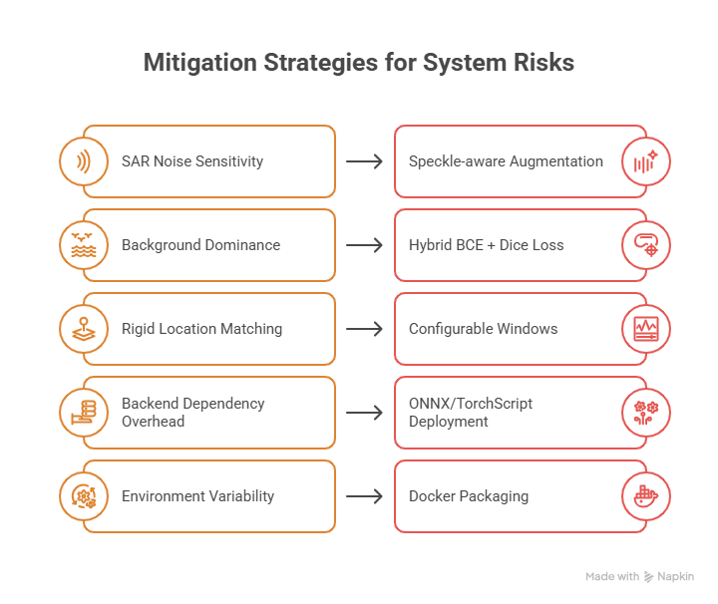
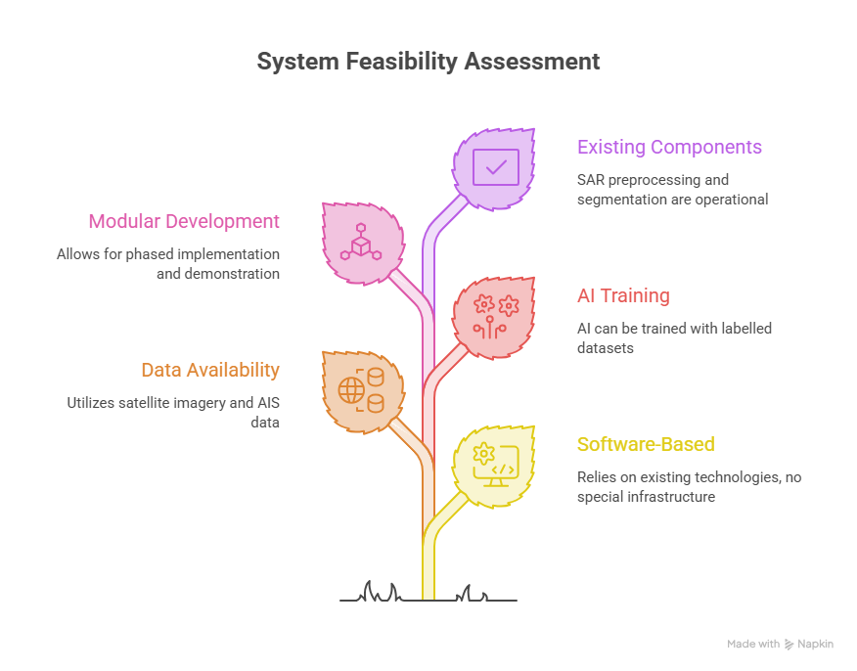
FEASIBILITY AND VIABILITY
SINGULARITY

Slide 5
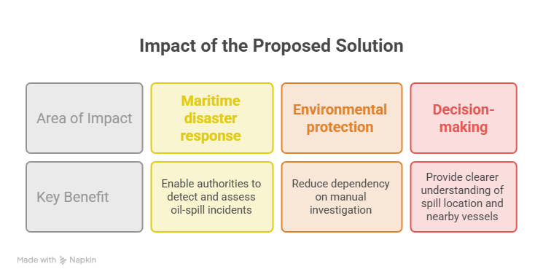
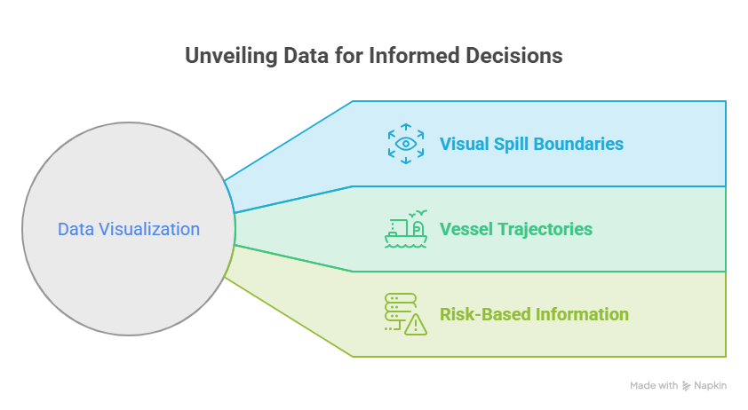
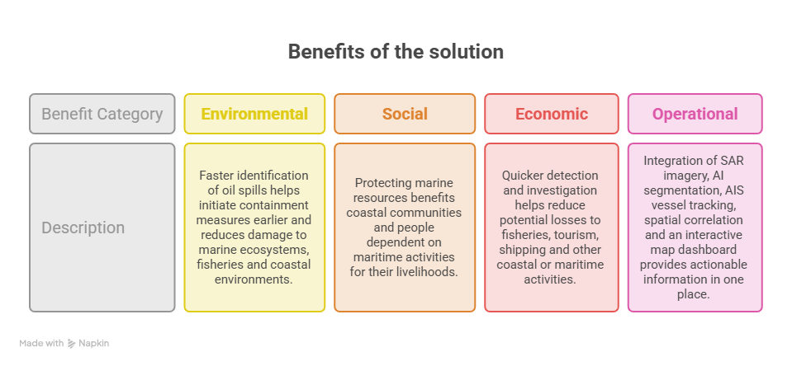
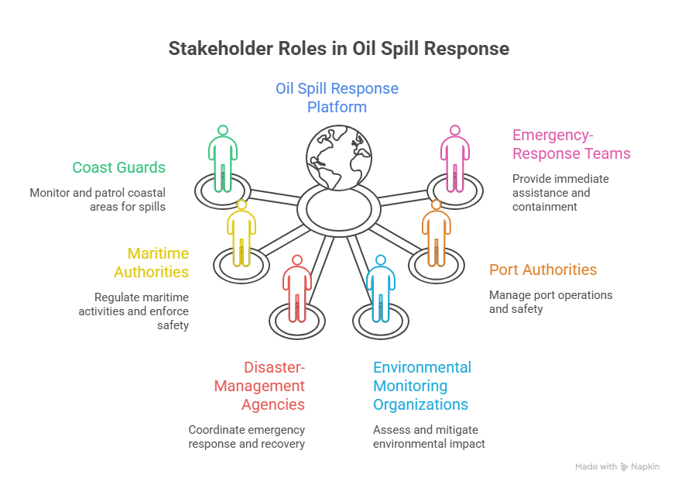
IMPACT AND BENEFITS
SINGULARITY

Slide 6
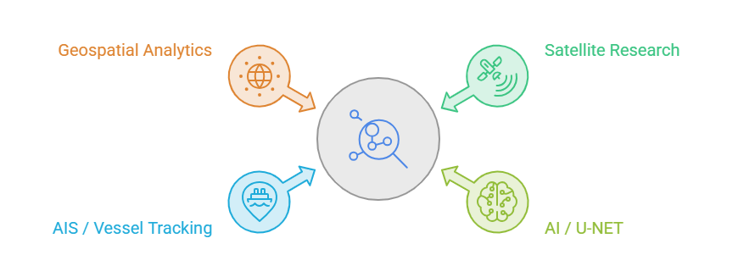
RESEARCH AND REFERENCES
SINGULARITY
Oil Spilling Detection at Marine Environment using AIS and Satellite Datasets - ResearchGate, 2025
A Synthetic Data-Driven Approach for Oil Spill Detection: Fine-Tuning YOLOv11-Seg with LIC-Based Ocean Flow Modeling - MDPI, Journal of Marine Science and Engineering
Automated Oil Spill Detection Using Deep Learning and SAR Satellite Data for the Northern Entrance of the Suez Canal - PMC, 2025
Smart India Hackathon 2026 - Problem Statement 26143, sih.gov.in

